Slide 1
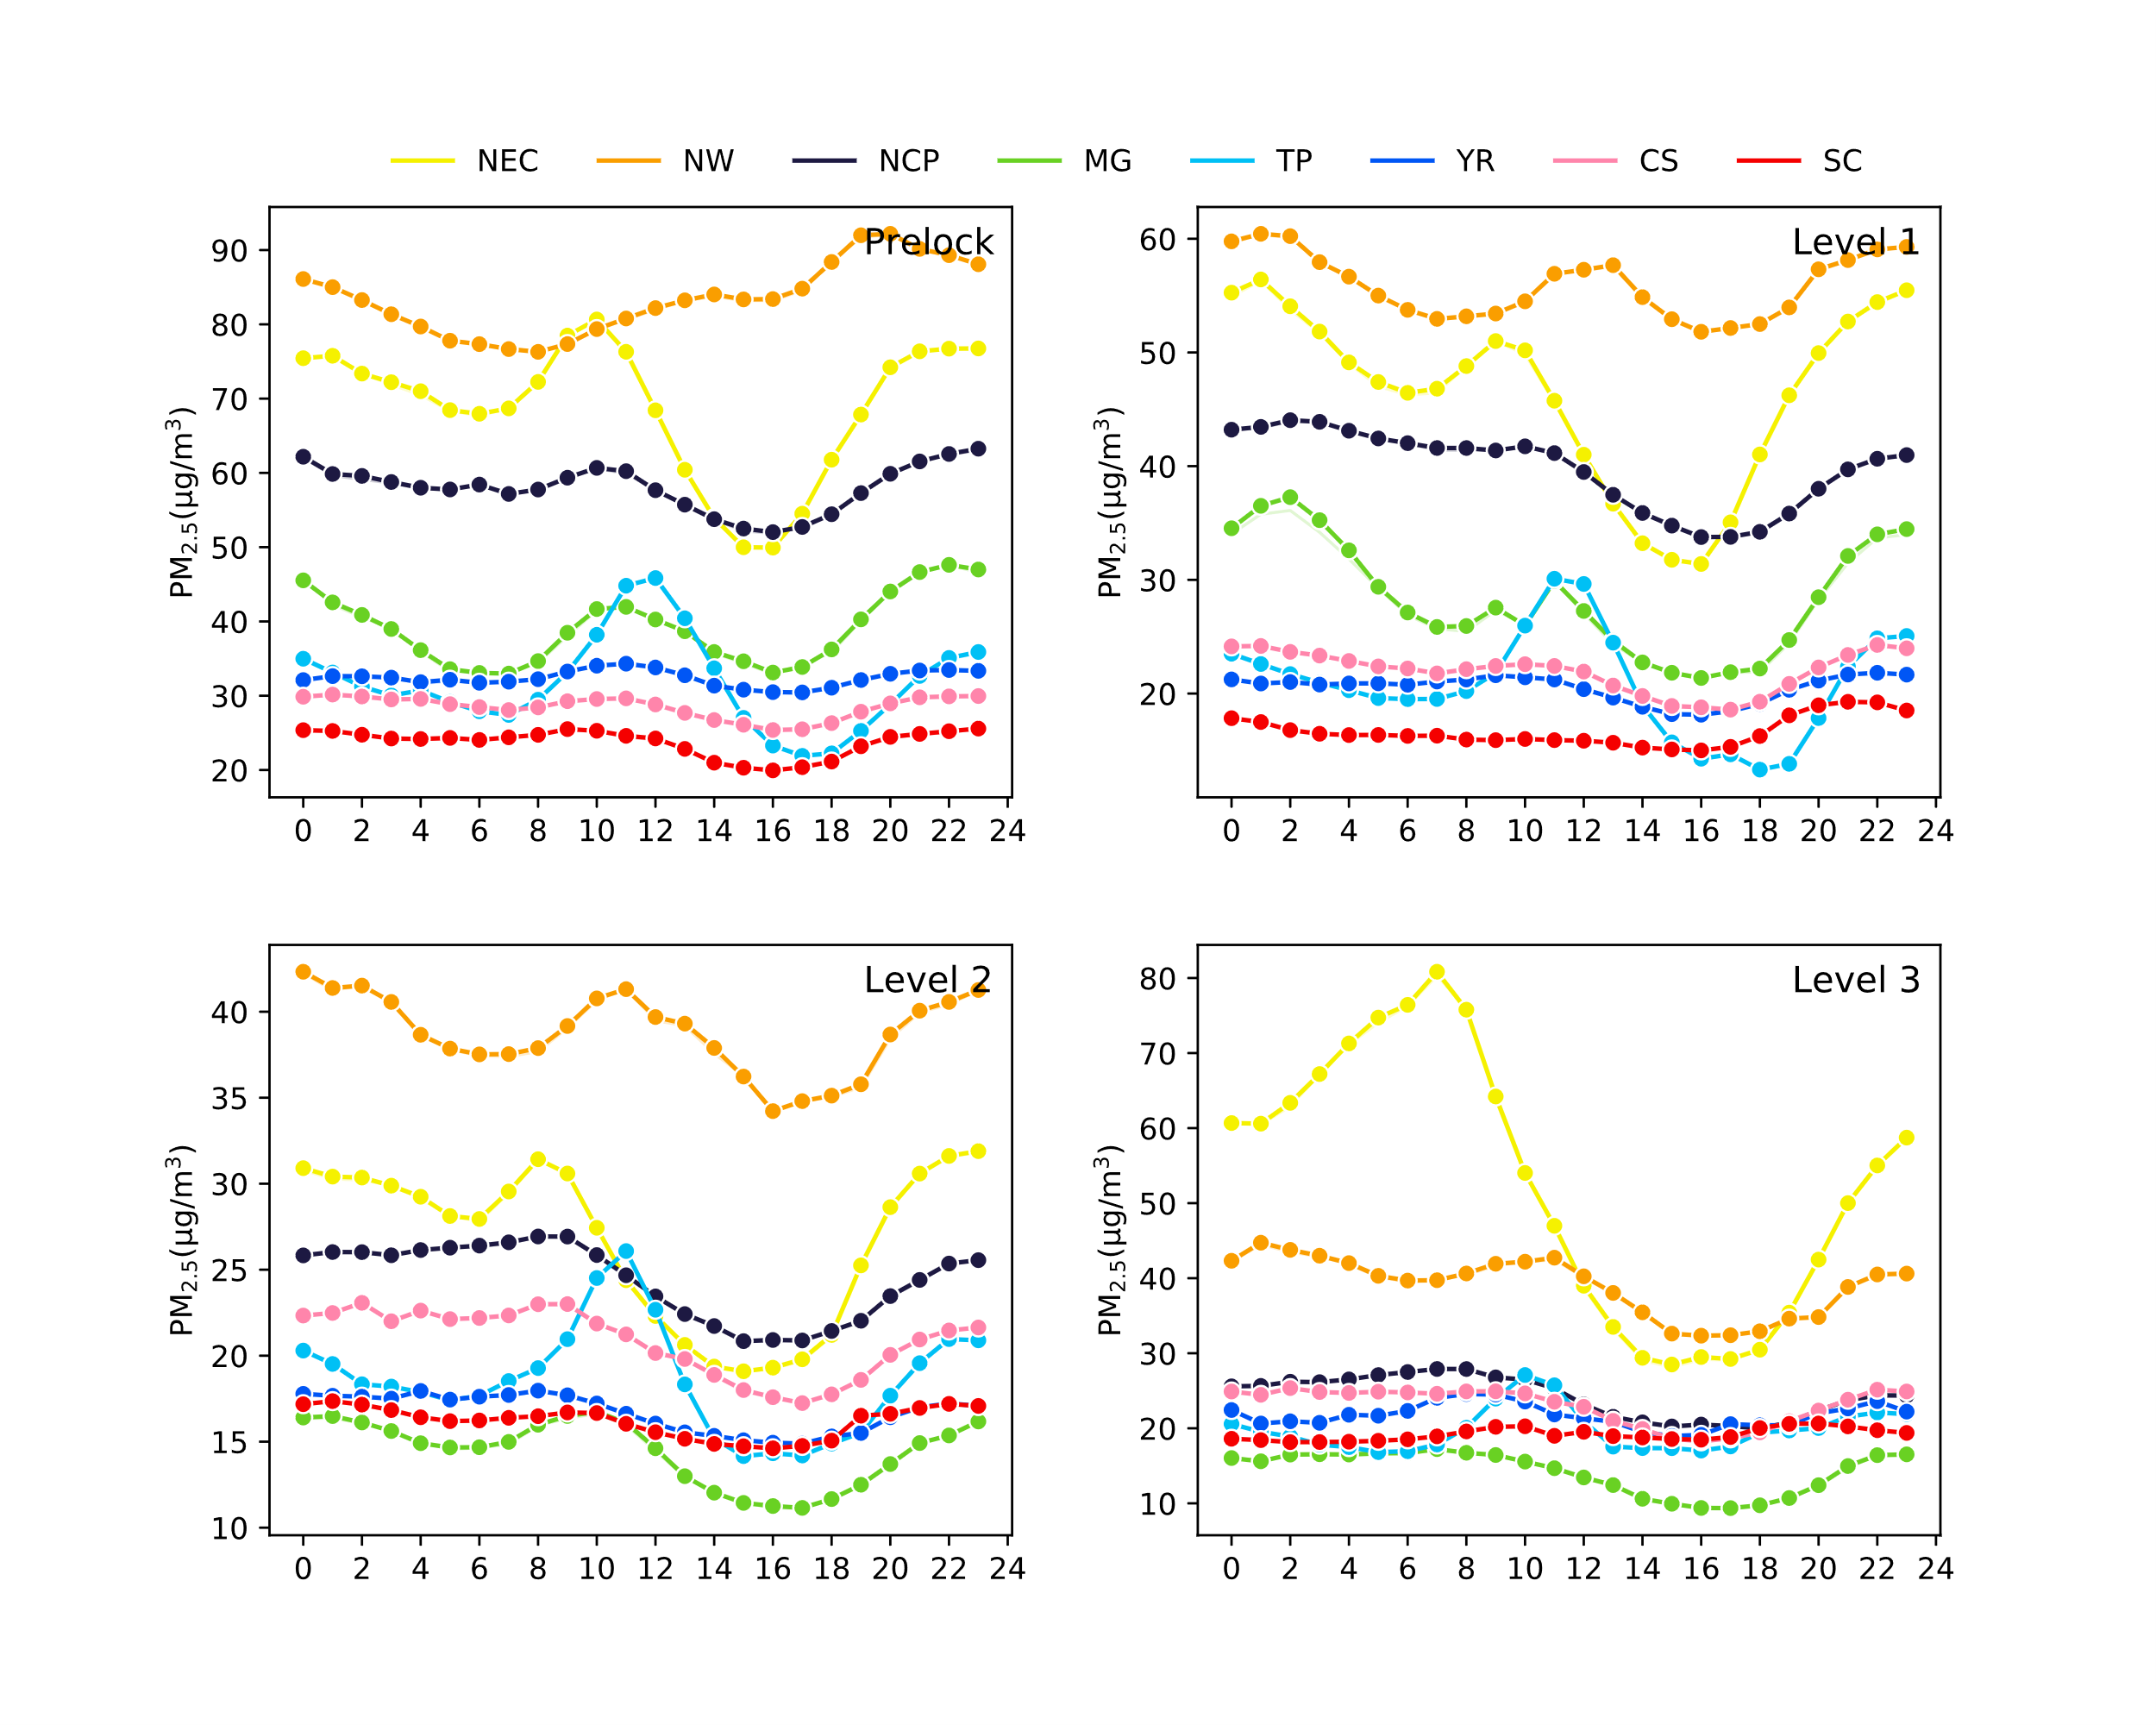
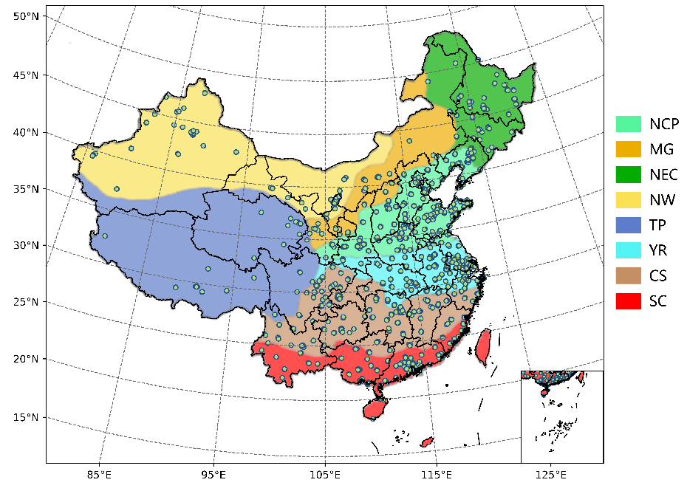
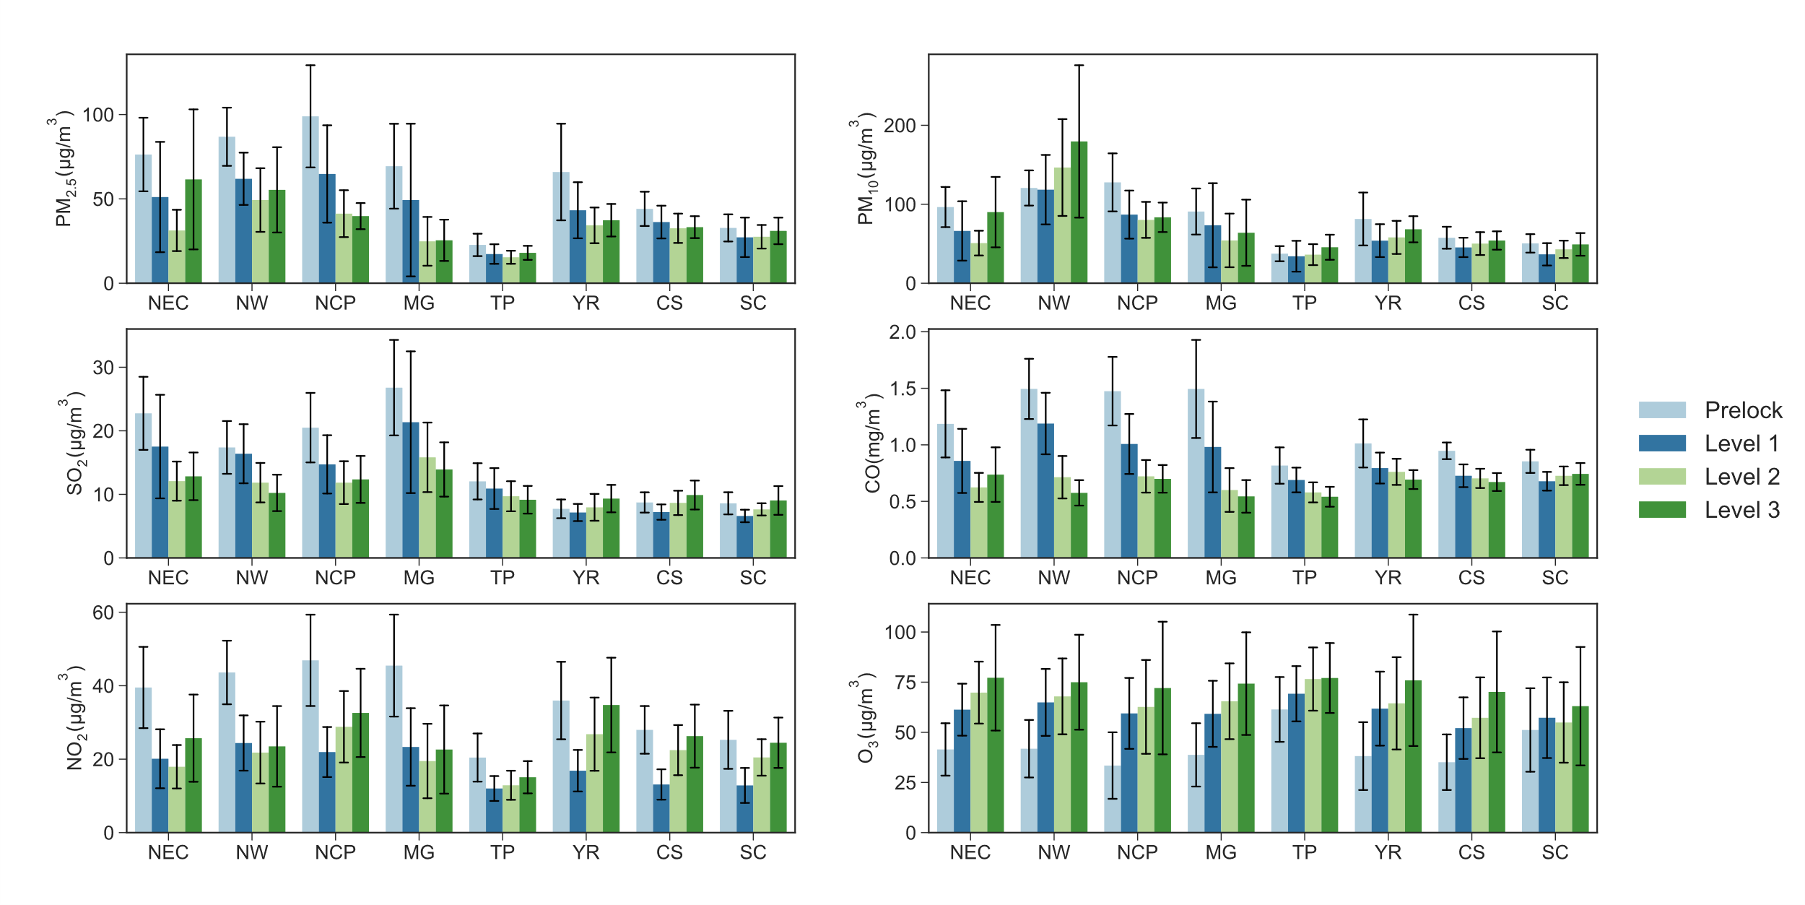
Air pollution changed during COVID-19 Lockdown
367 Cities
109 days
1634 sites
Considering
meteorological changes
& economical differences
4 Periods through the Lockdown
The concentration changes (average & diurnal) of 6 Pollutants
8 Regions in China

